Slide 1


Sarah and Gaurav
Welcome to Our Wedding
27 June 2025

Slide 2
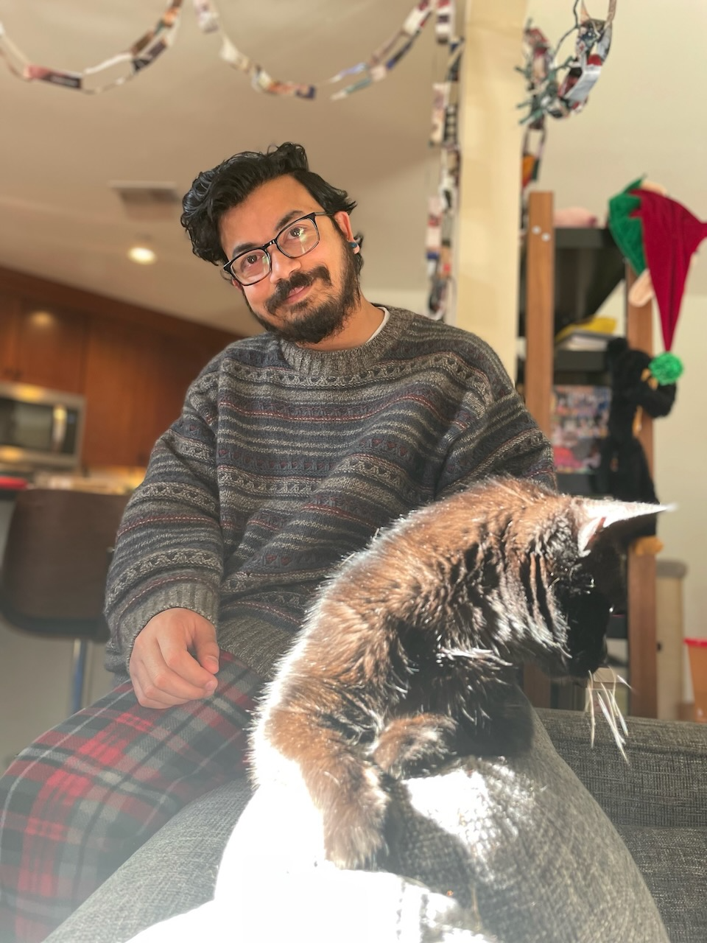
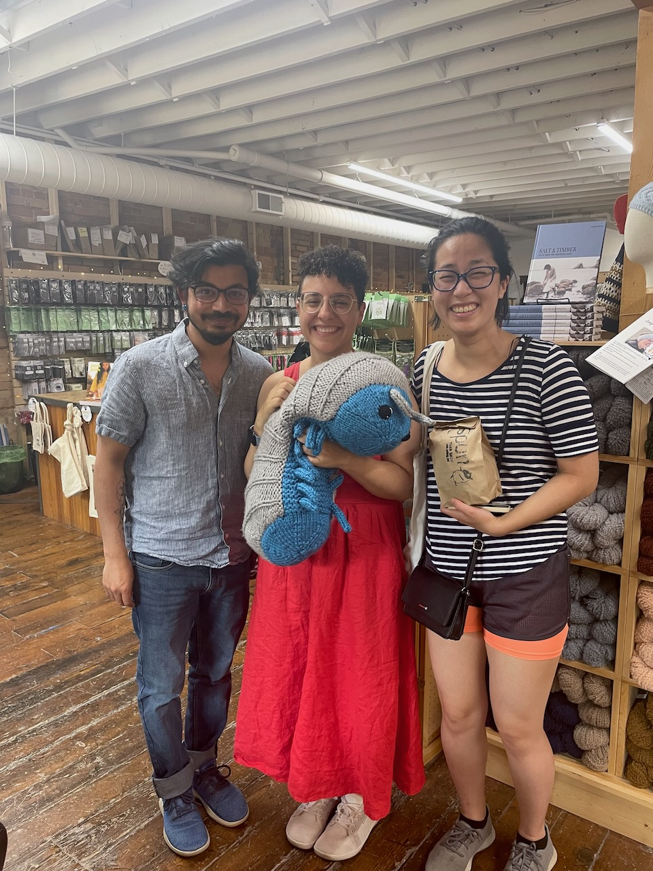
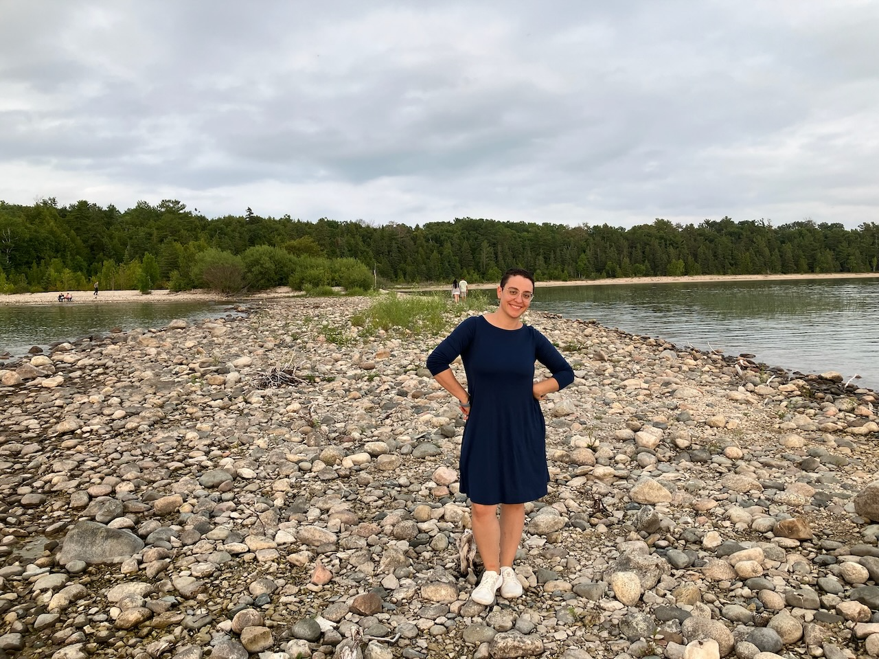
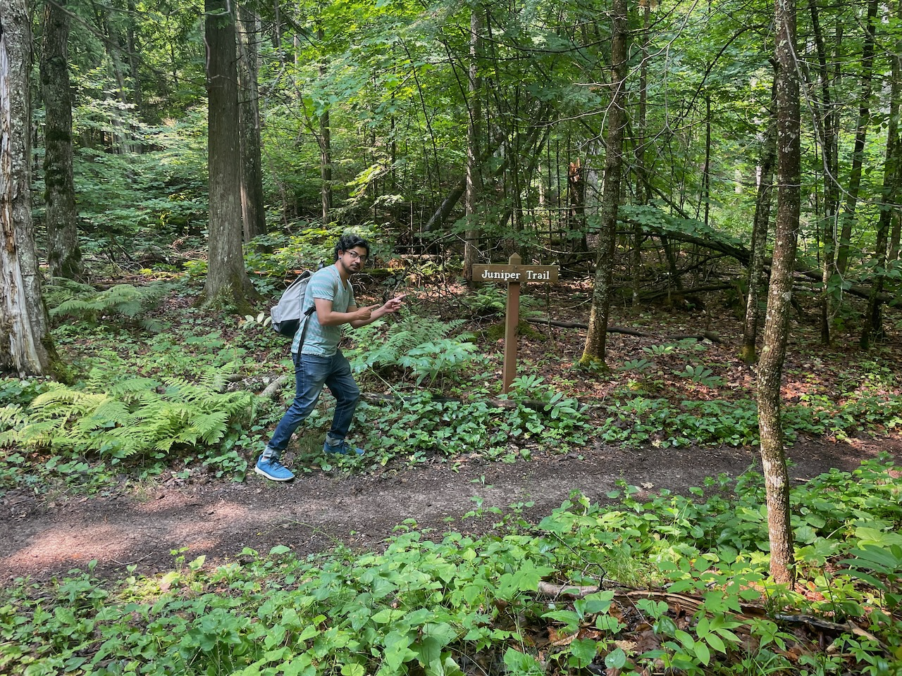
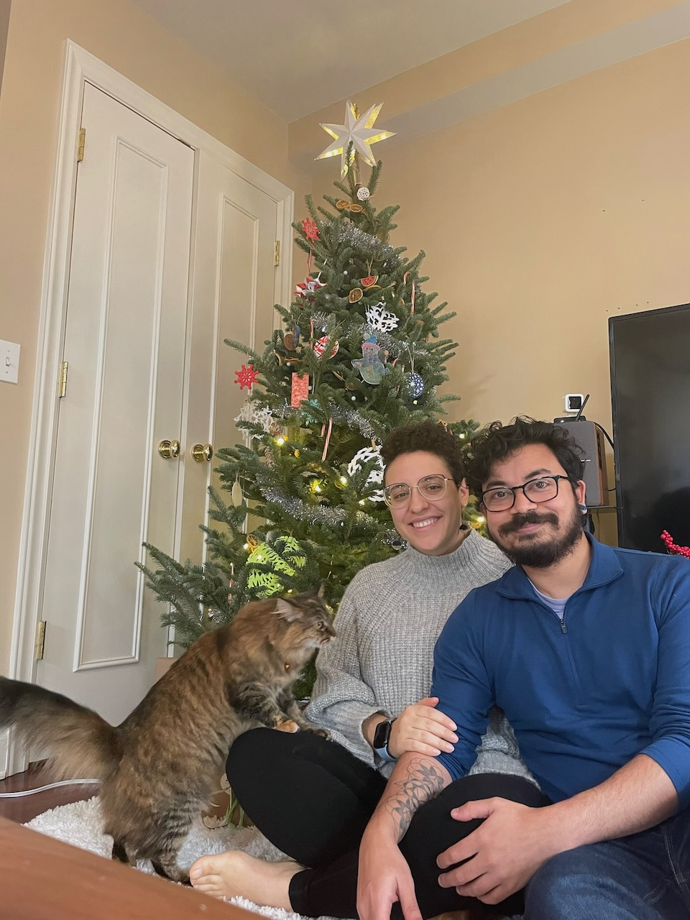
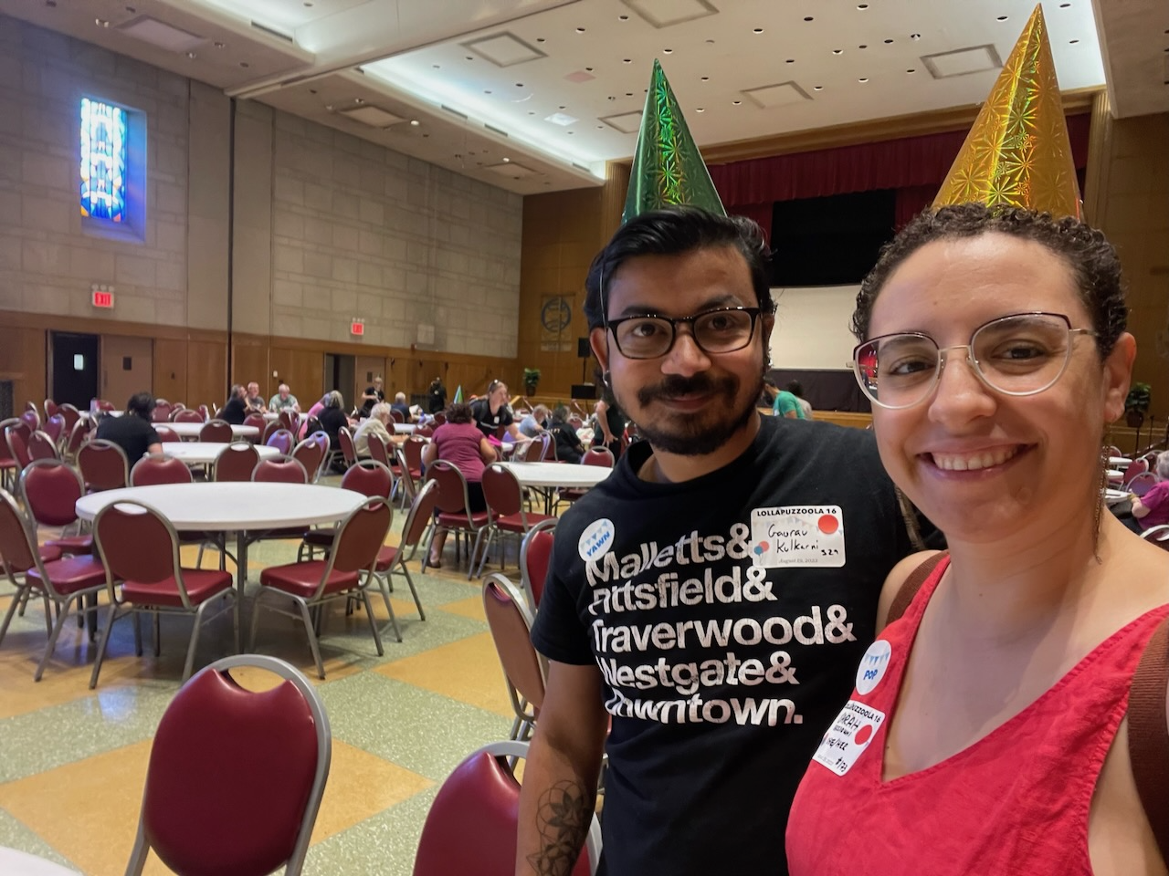
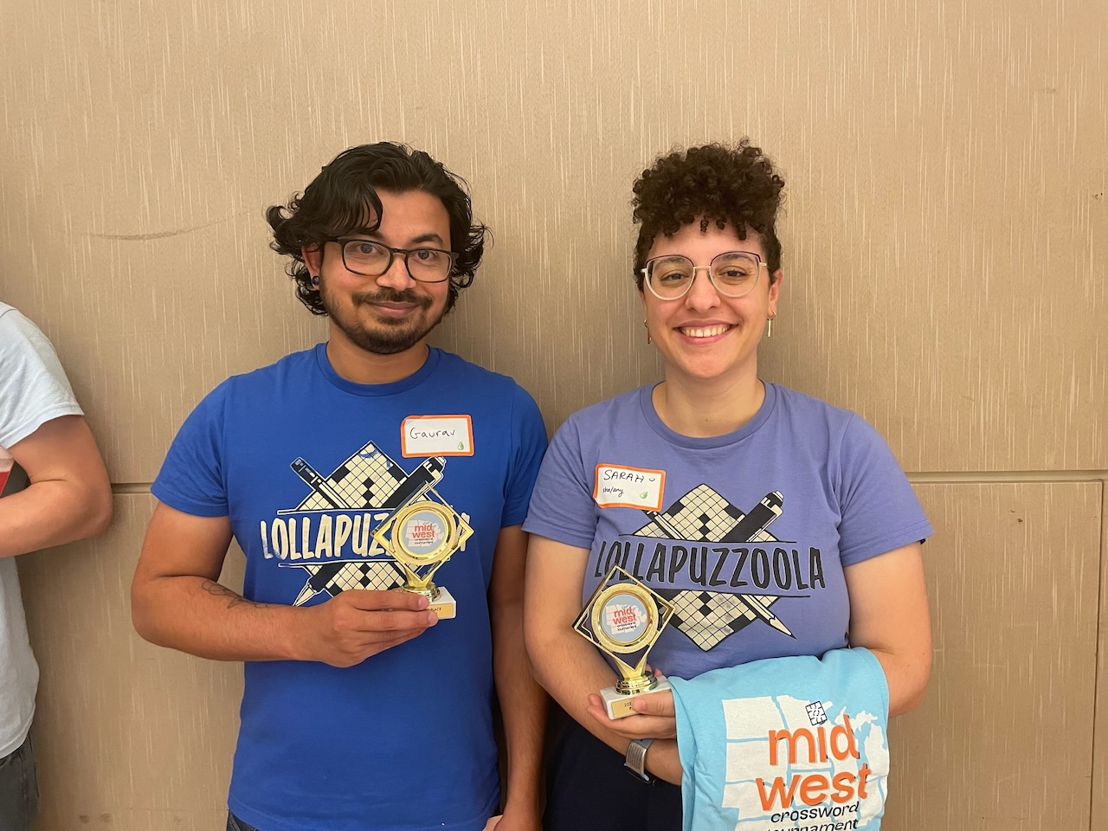
Sarah + Gaurav
Our Story
Meet Cute
Summer Game 2023
Mackinaw
First Dates
First Crossword Tournament
First Holiday Season
Eclipse 2024
Amtrak to San Francisco
Gardening Together

Slide 3
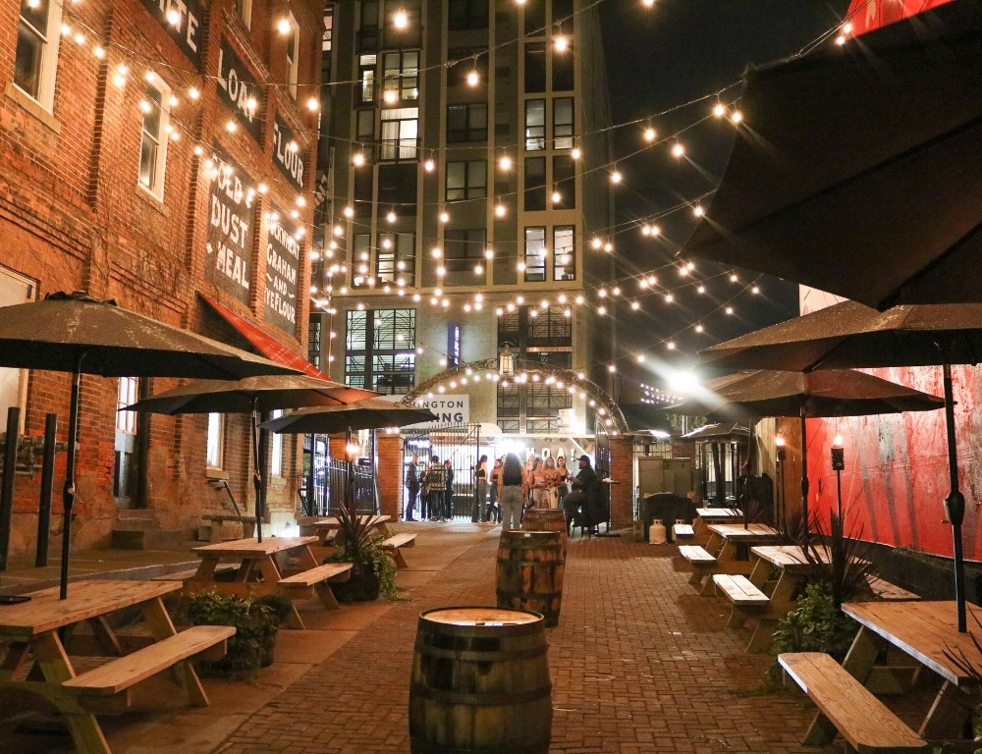
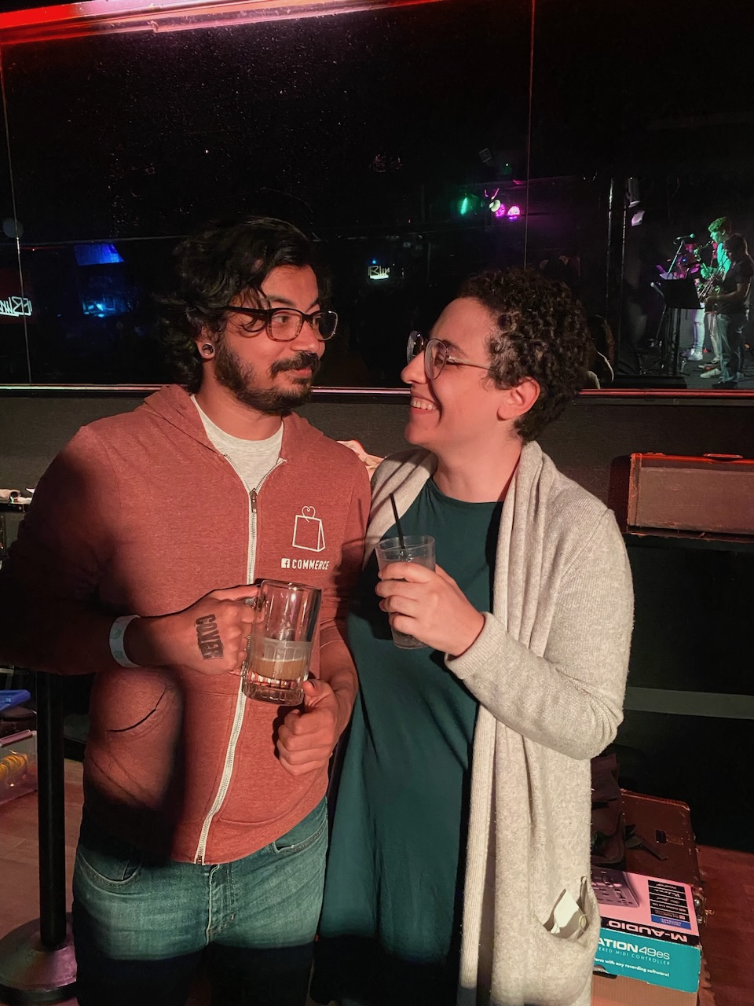
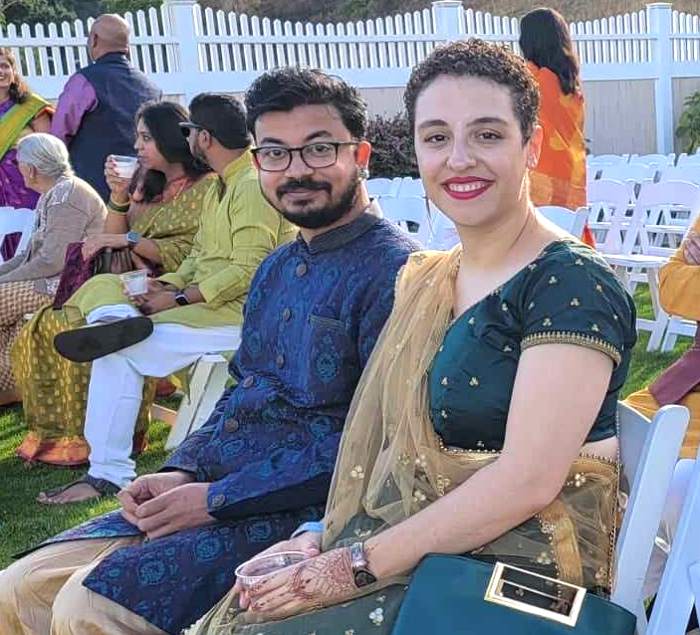
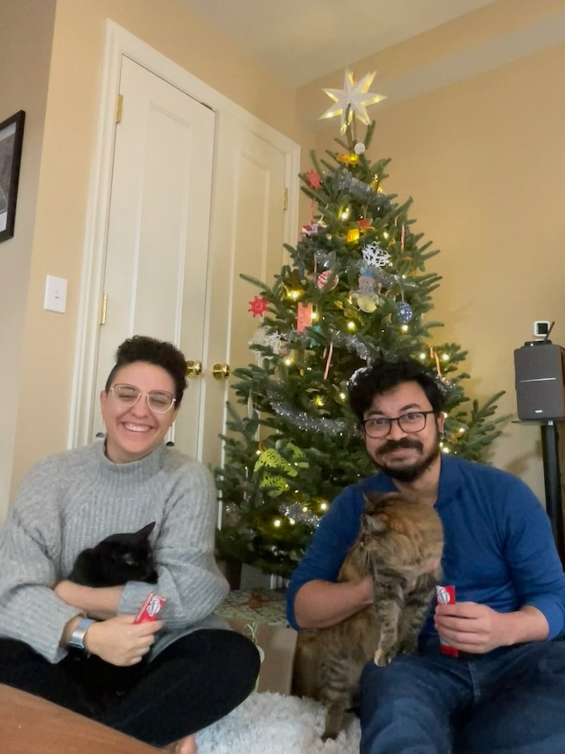
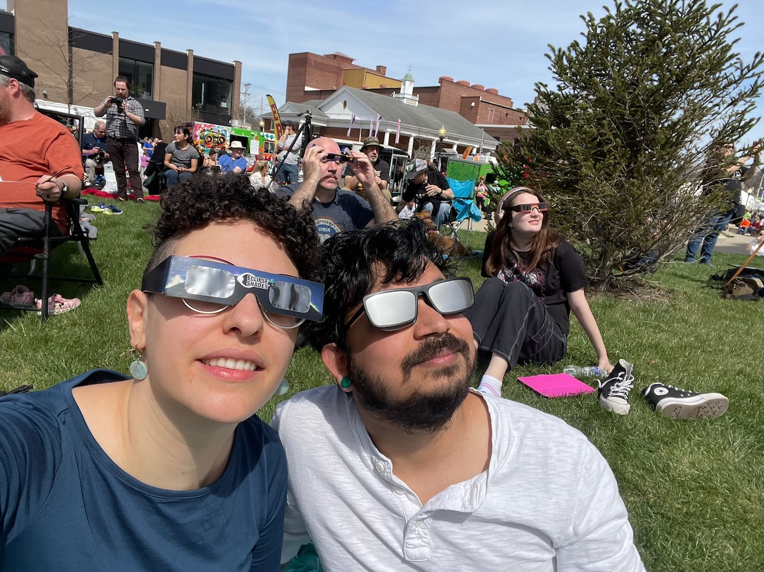
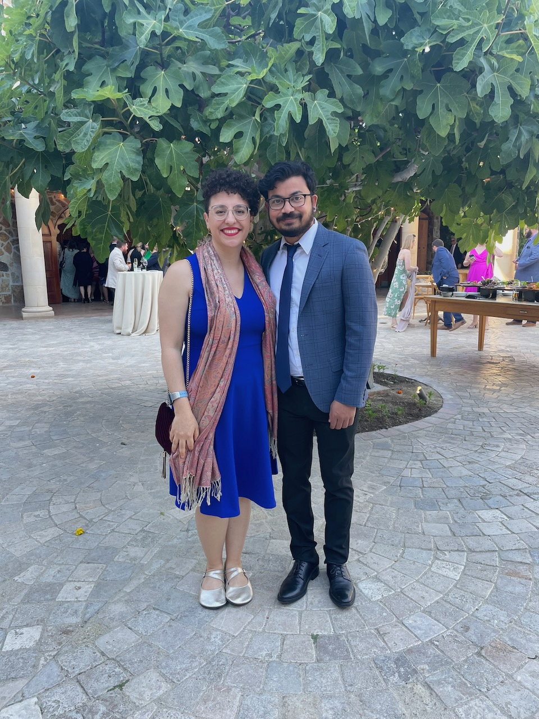
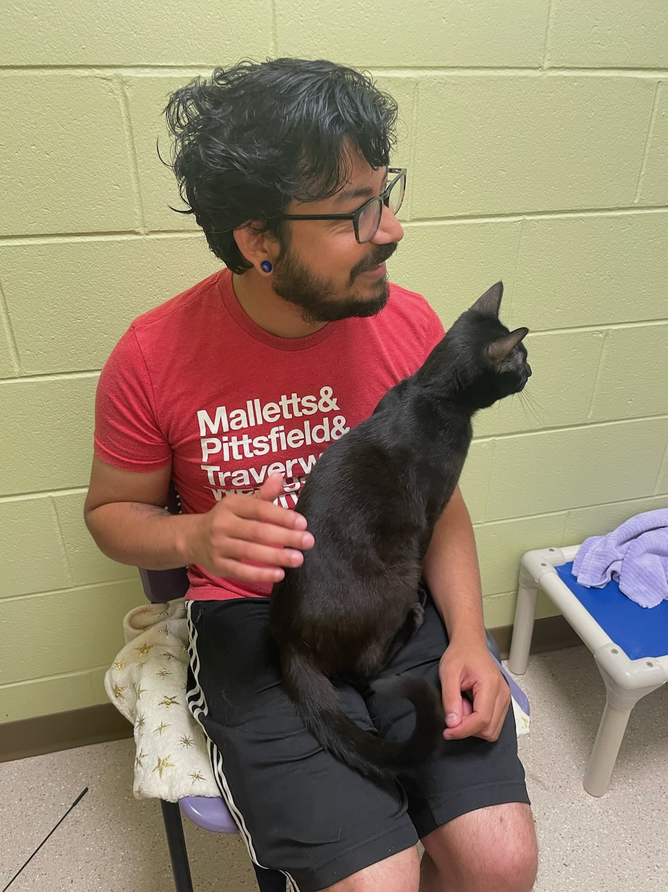
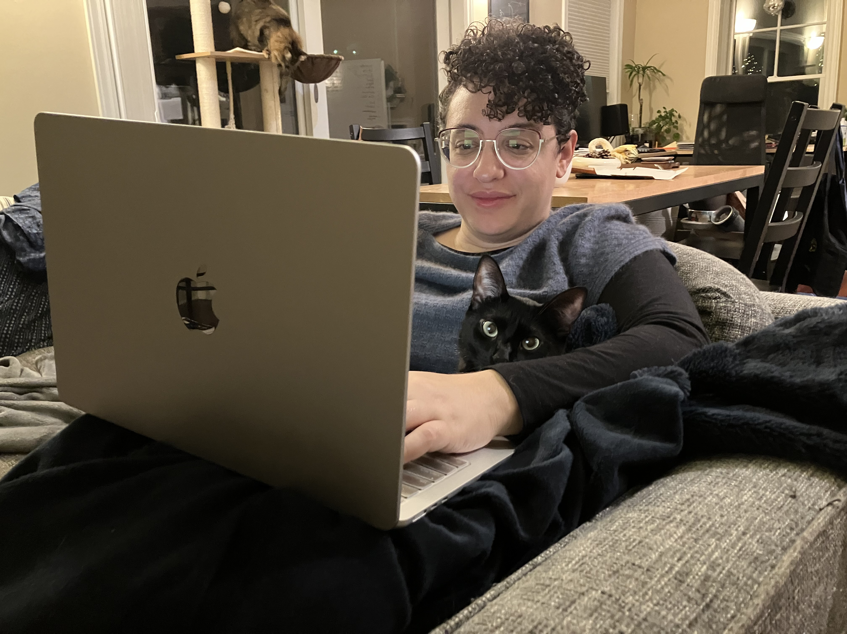
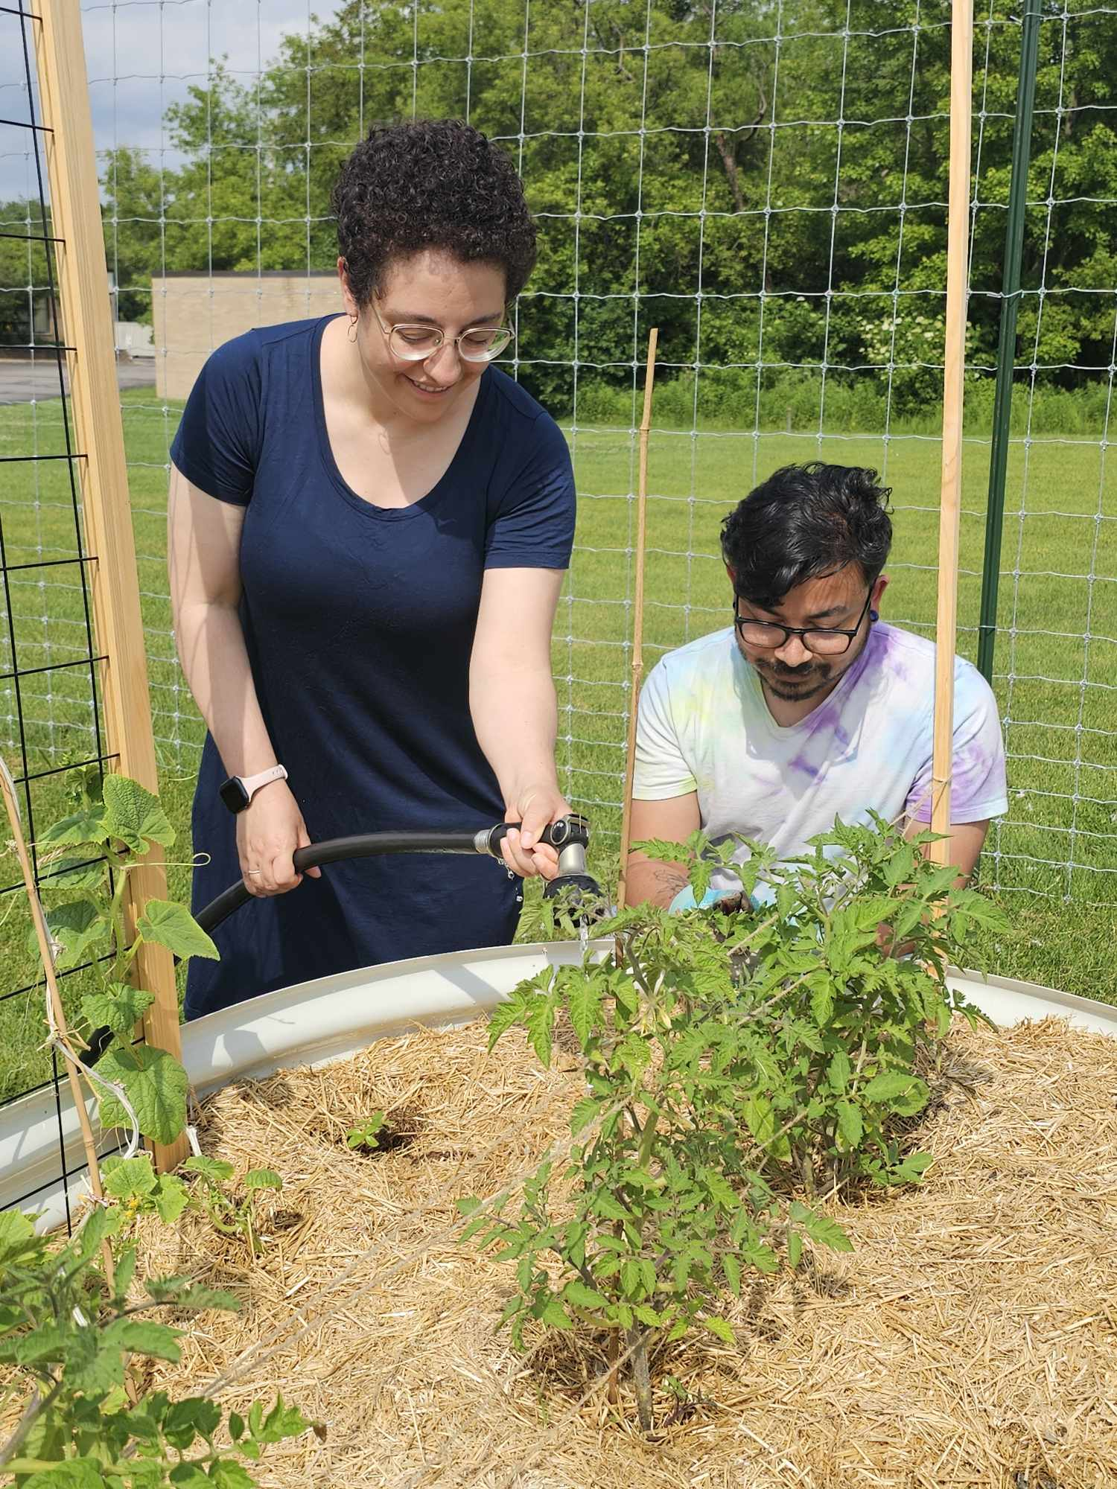
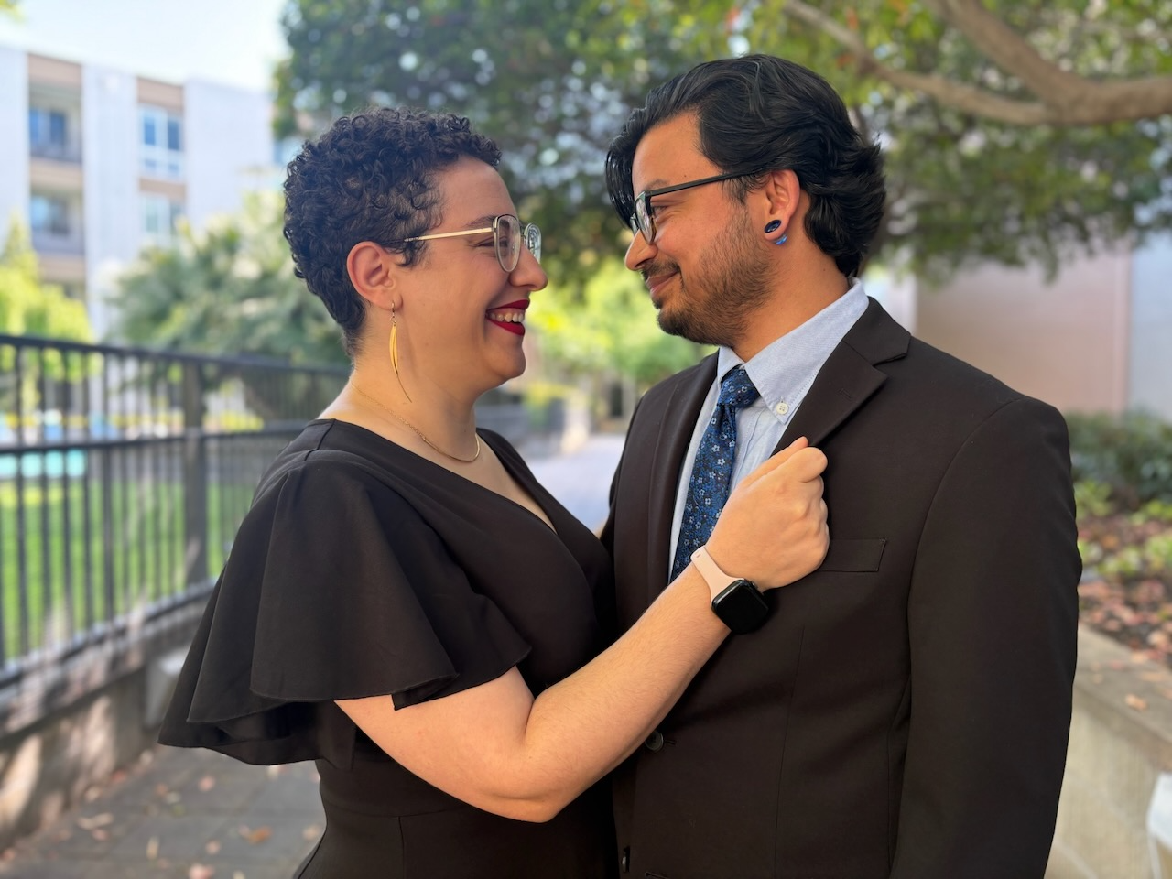
Sarah + Gaurav
Our Story
Meet Cute
We met on March 2, 2023 at Circ trivia. Sarah was eager to learn some factoids before returning to comps studying and Gaurav was looking forward to meeting new folks. Over questions about movies and history, we found we had a lot in common and really enjoyed talking to each other.
Summer Game 2023
Gaurav introduced Sarah to AADL’s iconic Summer Game. It was a wonderful way to get to know each other, plus we got points at the end for some fun prizes. Little did we know the best prize would be each other ♡
Mackinaw City
The forecast said there would be aurora borealis viewable from Mackinaw City dark park, so we took a quick road trip. Unfortunately, no aurora was seen but that’s okay, we only had eyes for each other anyway.
First Dates
Throughout the rest of summer 2023 and into the fall, we got to explore Ann Arbor and Southeast Michigan together: Dexter Cider Mill, Ferndale, and more! We also got to spend time with friends and meet new ones.
First Crossword Tournament
Did you know there’s a crossword tournament called Lollapuzzoola? Sarah didn’t! But Gaurav did and as soon as Sarah heard about it, she was all in. We’ve been going every year since 2023 and look forward to keeping this tradition for years to come.
First Holiday Season Together
December is a time for coziness and art projects. We got our first tree, and with the help of our friends, painted ornaments and decorated. With a little bribing, the cats cooperated long enough for one photo as a whole family.
Solar Eclipse
The moon covered the sun for a brief time and we just had to be there. We drove down to Ohio and explored some wonderful small towns too.
Amtrak to San Francisco
We love trains and try to take them as often as we can. So, of course, when we had the chance to go to San Francisco via Amtrak to attend a friend’s wedding, we jumped at the chance. It was a gorgeous route and we got to meet some fun folks along the way.
Our Family Grows By One
On a spontaneous visit to the Huron Valley Humane Society in June 2024, we met a snuggle bug of a kitten we named Sesame and welcomed him into our home. Now Juniper and Midnight have a brother!
Gardening Together
Backyard gardening was a common feature of Sarah’s childhood (shukran Mama and Baba!). Summer 2024, we started small on our balcony garden. This year, we’ve expanded to a Project Grow community garden raised bed. Gaurav started plants from seed and they’re thriving both on the balcony and in the raised bed. Excited to have a mighty harvest this year and to continue gardening together for years to come.
Getting Married!
And now we’re here! We’re so happy to be able to celebrate today, and many future years, with you ♡

Slide 4
Sarah + Gaurav
Our Story
Meet Cute
We met on March 2, 2023 at Circ trivia. Sarah was eager to learn some factoids before returning to comps studying and Gaurav was looking forward to meeting new folks. Over questions about movies and history, we found we had a lot in common and really enjoyed talking to each other.
Summer Game 2023
Gaurav introduced Sarah to AADL’s iconic Summer Game. It was a wonderful way to get to know each other, plus we got points at the end for some fun prizes. Little did we know the best prize would be each other ♡
Mackinaw City
The forecast said there would be aurora borealis viewable from Mackinaw City dark park, so we took a quick road trip. Unfortunately, no aurora was seen but that’s okay, we only had eyes for each other anyway.
First Dates
Throughout the rest of summer 2023 and into the fall, we got to explore Ann Arbor and Southeast Michigan together: Dexter Cider Mill, Ferndale, and more! We also got to spend time with friends and meet new ones.
First Crossword Tournament
Did you know there’s a crossword tournament called Lollapuzzoola? Sarah didn’t! But Gaurav did and as soon as Sarah heard about it, she was all in. We’ve been going every year since 2023 and look forward to keeping this tradition for years to come.
First Holiday Season Together
December is a time for coziness and art projects. We got our first tree, and with the help of our friends, painted ornaments and decorated. With a little bribing, the cats cooperated long enough for one photo as a whole family.
Solar Eclipse
The moon covered the sun for a brief time and we just had to be there. We drove down to Ohio and explored some wonderful small towns too.
Amtrak to San Francisco
We love trains and try to take them as often as we can. So, of course, when we had the chance to go to San Francisco via Amtrak to attend a friend’s wedding, we jumped at the chance. It was a gorgeous route and we got to meet some fun folks along the way.
Our Family Grows By One
On a spontaneous visit to the Huron Valley Humane Society in June 2024, we met a snuggle bug of a kitten we named Sesame and welcomed him into our home. Now Juniper and Midnight have a brother!
Gardening Together
Backyard gardening was a common feature of Sarah’s childhood (shukran Mama and Baba!). Summer 2024, we started small on our balcony garden. This year, we’ve expanded to a Project Grow community garden raised bed. Gaurav started plants from seed and they’re thriving both on the balcony and in the raised bed. Excited to have a mighty harvest this year and to continue gardening together for years to come.
Getting Married!
And now we’re here! We’re so happy to be able to celebrate today, and many future years, with you ♡

Slide 5
Sarah + Gaurav
Our Story
Meet Cute
We met on March 2, 2023 at Circ trivia. Sarah was eager to learn some factoids before returning to comps studying and Gaurav was looking forward to meeting new folks. Over questions about movies and history, we found we had a lot in common and really enjoyed talking to each other.
Summer Game 2023
Gaurav introduced Sarah to AADL’s iconic Summer Game. It was a wonderful way to get to know each other, plus we got points at the end for some fun prizes. Little did we know the best prize would be each other ♡
Mackinaw City
The forecast said there would be aurora borealis viewable from Mackinaw City dark park, so we took a quick road trip. Unfortunately, no aurora was seen but that’s okay, we only had eyes for each other anyway.
First Dates
Throughout the rest of summer 2023 and into the fall, we got to explore Ann Arbor and Southeast Michigan together: Dexter Cider Mill, Ferndale, and more! We also got to spend time with friends and meet new ones.
First Crossword Tournament
Did you know there’s a crossword tournament called Lollapuzzoola? Sarah didn’t! But Gaurav did and as soon as Sarah heard about it, she was all in. We’ve been going every year since 2023 and look forward to keeping this tradition for years to come.
First Holiday Season Together
December is a time for coziness and art projects. We got our first tree, and with the help of our friends, painted ornaments and decorated. With a little bribing, the cats cooperated long enough for one photo as a whole family.
Solar Eclipse
The moon covered the sun for a brief time and we just had to be there. We drove down to Ohio and explored some wonderful small towns too.
Amtrak to San Francisco
We love trains and try to take them as often as we can. So, of course, when we had the chance to go to San Francisco via Amtrak to attend a friend’s wedding, we jumped at the chance. It was a gorgeous route and we got to meet some fun folks along the way.
Our Family Grows By One
On a spontaneous visit to the Huron Valley Humane Society in June 2024, we met a snuggle bug of a kitten we named Sesame and welcomed him into our home. Now Juniper and Midnight have a brother!
Gardening Together
Backyard gardening was a common feature of Sarah’s childhood (shukran Mama and Baba!). Summer 2024, we started small on our balcony garden. This year, we’ve expanded to a Project Grow community garden raised bed. Gaurav started plants from seed and they’re thriving both on the balcony and in the raised bed. Excited to have a mighty harvest this year and to continue gardening together for years to come.
Getting Married!
And now we’re here! We’re so happy to be able to celebrate today, and many future years, with you ♡

Slide 7
Our Story
Sarah + Gaurav
Meet Cute
2023
We met on March 2, 2023 at Circ trivia. Sarah was eager to learn some factoids before returning to comps studying and Gaurav was looking forward to meeting new folks. Over questions about movies and history, we found we had a lot in common and really enjoyed talking to each other.
Summer Game
Gaurav introduced Sarah to AADL’s iconic Summer Game. It was a wonderful way to get to know each other, plus we got points at the end for some fun prizes. Little did we know the best prize would be each other ♡
Mackinaw City
The forecast said that the aurora borealis would be viewable from Mackinaw City, so we took a quick road trip. Unfortunately, no aurora was seen but that’s okay, we only had eyes for each other anyway.
First Dates
Throughout the rest of summer and into the fall, we got to explore Ann Arbor and Southeast Michigan together: Dexter Cider Mill, Ferndale, and more! We also got to spend time with friends and meet new ones.
First Crossword Tournament
Did you know there’s a crossword tournament called Lollapuzzoola? Sarah didn’t! But Gaurav did and as soon as Sarah heard about it, she was all in. We’ve been going every year since 2023 and look forward to keeping this tradition for years to come.
First Holiday Season Together
December is a time for coziness and art projects. We got our first tree, and with the help of our friends, painted ornaments and decorated. With a little bribing, the cats cooperated long enough for one photo as a whole family.
Solar Eclipse
2024
The moon covered the sun for a brief time, and we just had to be there. We drove down to Ohio and explored some wonderful small towns too.
Amtrak to San Francisco
We love trains and try to take them as often as we can. So, of course, when we had the chance to go to San Francisco via Amtrak to attend a friend’s wedding, we jumped at the chance. It was a gorgeous route, and we got to meet some fun folks along the way.
Our Family Grows By One
On a spontaneous visit to the Huron Valley Humane Society in June, we met a snuggle bug of a kitten we named Sesame and welcomed him into our home. Now Juniper and Midnight have a brother!
Gardening Together
We started small with our balcony garden and have now expanded to a Project Grow community garden raised bed. We’re excited to continue gardening for years to come.
Getting Married!
2025
And now we’re here! We’re so happy to be able to celebrate today, and many future years, with you ♡

Slide 8
Our Story
Sarah + Gaurav
Meet Cute
2023
We met on March 2, 2023 at Circ trivia. Sarah was eager to learn some factoids before returning to comps studying and Gaurav was looking forward to meeting new folks. Over questions about movies and history, we found we had a lot in common and really enjoyed talking to each other.
Summer Game
Gaurav introduced Sarah to AADL’s iconic Summer Game. It was a wonderful way to get to know each other, plus we got points at the end for some fun prizes. Little did we know the best prize would be each other ♡
Mackinaw City
The forecast said that the aurora borealis would be viewable from Mackinaw City, so we took a quick road trip. Unfortunately, no aurora was seen but that’s okay, we only had eyes for each other anyway.
First Dates
Throughout the rest of summer and into the fall, we got to explore Ann Arbor and Southeast Michigan together: Dexter Cider Mill, Ferndale, and more! We also got to spend time with friends and meet new ones.
First Crossword Tournament
Did you know there’s a crossword tournament called Lollapuzzoola? Sarah didn’t! But Gaurav did and as soon as Sarah heard about it, she was all in. We’ve been going every year since 2023 and look forward to keeping this tradition for years to come.
First Holiday Season Together
December is a time for coziness and art projects. We got our first tree, and with the help of our friends, painted ornaments and decorated. With a little bribing, the cats cooperated long enough for one photo as a whole family.
Solar Eclipse
2024
The moon covered the sun for a brief time, and we just had to be there. We drove down to Ohio and explored some wonderful small towns too.
Amtrak to San Francisco
We love trains and try to take them as often as we can. So, of course, when we had the chance to go to San Francisco via Amtrak to attend a friend’s wedding, we jumped at the chance. It was a gorgeous route, and we got to meet some fun folks along the way.
Our Family Grows By One
On a spontaneous visit to the Huron Valley Humane Society in June, we met a snuggle bug of a kitten we named Sesame and welcomed him into our home. Now Juniper and Midnight have a brother!
Gardening Together
We started small with our balcony garden and have now expanded to a Project Grow community garden raised bed. We’re excited to continue gardening for years to come.
Getting Married!
2025
And now we’re here! We’re so happy to be able to celebrate today, and many future years, with you ♡

